Slide 1


DESIGN AND IMPLEMENTATION OF AN IOT SYSTEM FOR CROP DISEASE DETECTION
SAMUEL JUSTIN IFIEZIBE 20211265072
OKEKE PRINCE PROSPER 20211286122
PRINCE IFEANYICHUKWU EJIMAKOR 20211257692
CHIDUBEM CHUKWUKA EMMANUEL 20222333192
SUPERVISOR: DR. AGUWA G. IHEANYICHUKWU

Slide 2

INTRODUCTION
Agricultural Importance: Agriculture is a pillar of human civilization, feeding over 70% of the global population.
Rural Livelihood: The sector provides the primary source of income for the majority of the rural population.
Food Insecurity: Approximately 257 million people in sub-Saharan Africa face acute food insecurity.
Yield Loss: Crop diseases cause pre-harvest losses of 20% to 40% globally, valued at over $220 billion annually.
The Solution: Offline Edge AI
Addressing the "Connectivity Gap" by bringing high-performance AI directly to the farm without requiring internet access.

Slide 3

PROBLEM STATEMENT
Six critical challenges drive this project:
Late Diagnosis: 5–7day delays in detecting diseases like Late Blight can destroy an entire season.
Subjectivity: Human visual inspection is inconsistent; similar-looking diseases (e.g., Early Blight vs. Septoria Spot) lead to misdiagnosis.
Expert Scarcity: Pathologists are urban-centered, leaving rural farmers without specialist guidance.
No Environmental Context: Disease spread is tied to temperature and humidity (e.g., Late Blight thrives at >90% RH), but current methods ignore these factors.
Data Absence: Farmers lack historical logs to identify seasonal patterns or hotspots.
Exclusionary Costs: Existing smart systems are expensive and dependent on cloud connectivity.

Slide 4

AIM AND OBJECTIVES
Aim: To automate crop disease detection using edge AI on dedicated NPU hardware, coupled with continuous environmental monitoring.
Key Objectives:
Hardware Integration: Combine Raspberry Pi 5, Hailo-8L NPU (26 TOPS), and DHT22 sensors into a low-cost unit.
Model Training: Achieve mAP >= 85% using YOLOv8 on the PlantVillage datasets.
NPU Deployment: Compile the model into Hailo Executable Format (HEF) for real-time inference (<10ms per frame).
System Integration: Develop a local SQLite database and a real-time web dashboard accessible via local network.
Alerting: Implement email or SMS notifications for high-severity detections.

Slide 5
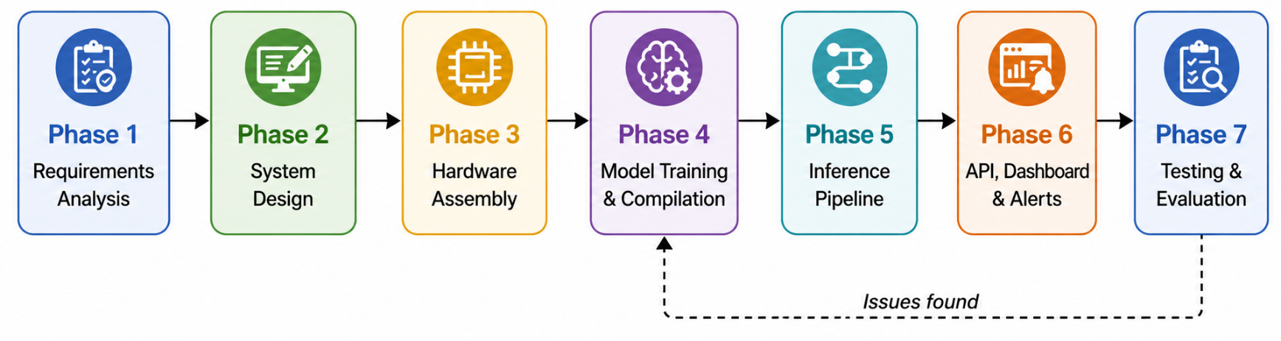
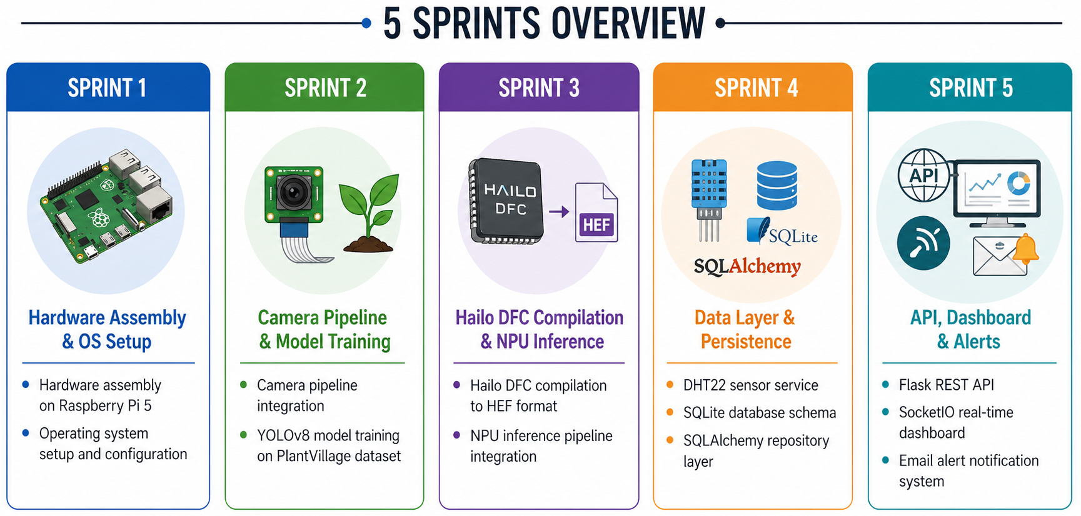
METHODOLOGY
Framework: Agile Software Development
A 5-sprint structure with iterative cycles covering hardware setup, model training, NPU compilation, sensor integration, and API/Dashboard development.

Slide 6

QUESTIONS?

Slide 7

Thank you for listening

